Slide 1
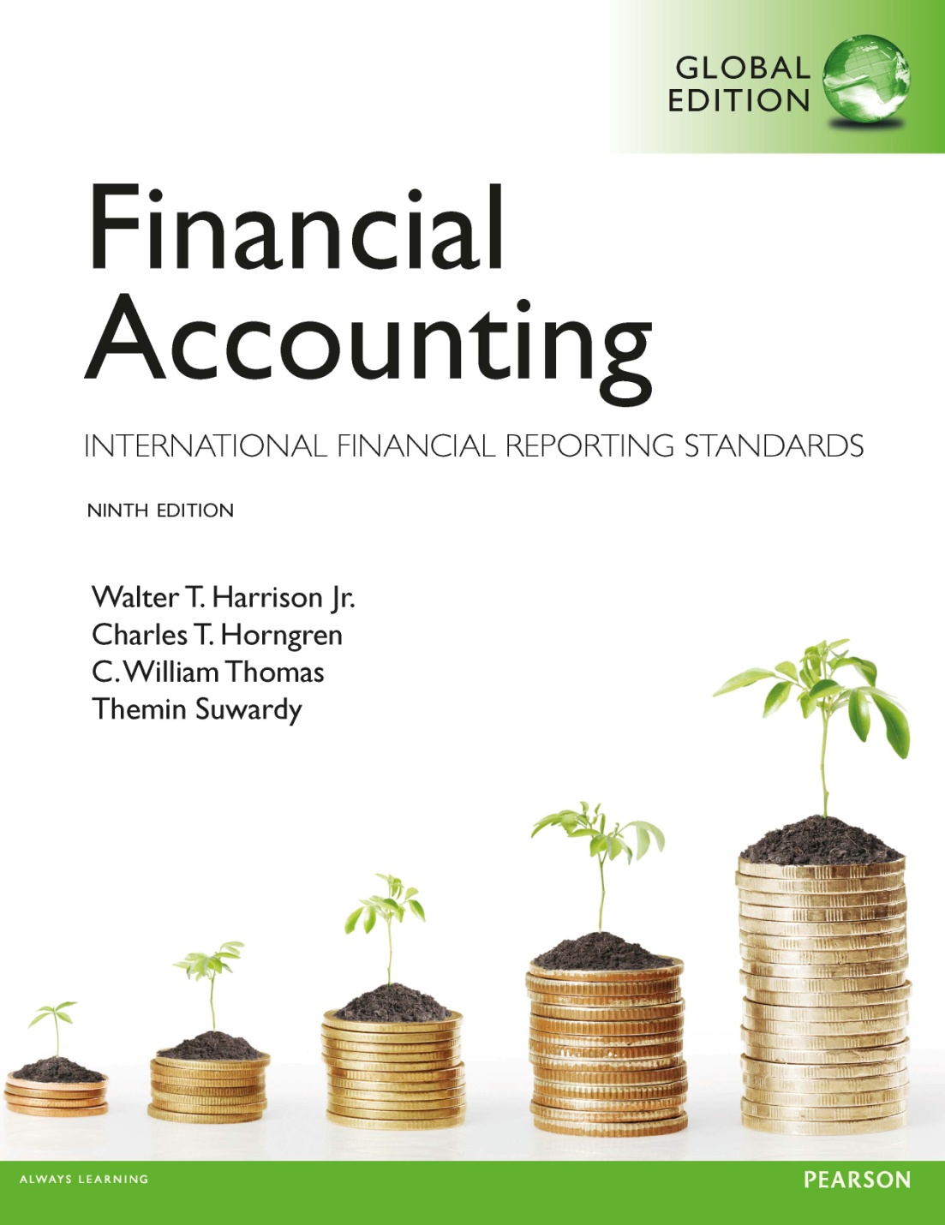
Chapter 2
Recording Business Transactions
Notes:
1

Slide 2
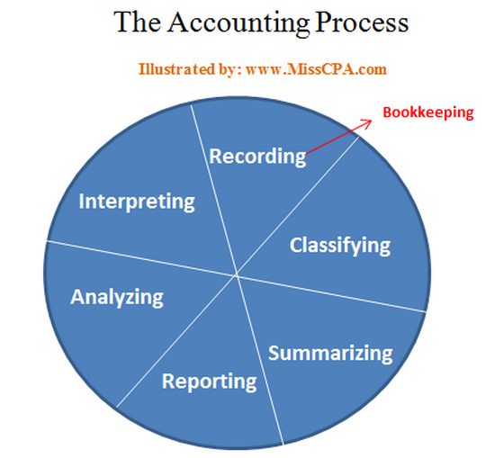
Chapter 1 Review
What is Accounting?
Basic assumptions?
Fundamental qualitative characteristics?
Accounting elements?
Basic Accounting equations?

Slide 3
Chapter 1 Review
The statement that shows transactions with shareholders and records changes in retained earnings is called…
Which statement is (are) stated at a point in time?
Which statement is (are) stated over a period of time?
What are the 3 categories of cash flows?
The order?

Slide 4
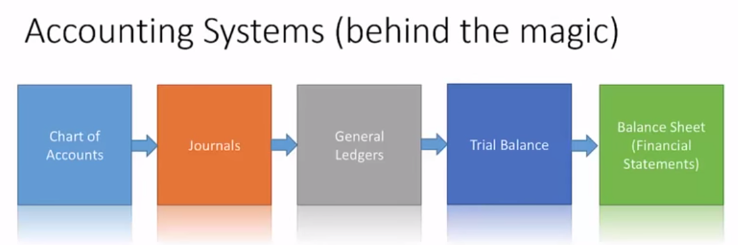
Today’s key points
How to record business transactions?
Double-entry system, rules of debit and credit
T- account
Notes:
不同行业的公司科目表会很不一样，课本上的主要是制造类的企业，金融行业的就会很不一样。
Double-entry system 复式记账法：任何一项交易都要涉及至少两个科目
Rules of debit and credit 借贷记账法
T-account T字账
Chart of accounts 科目表
Journals日记账

Slide 5
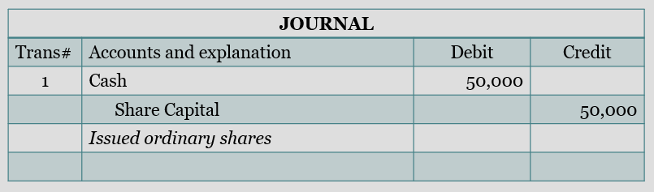
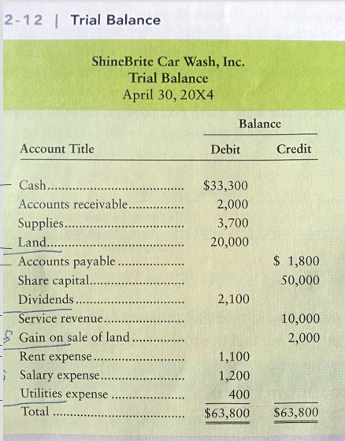
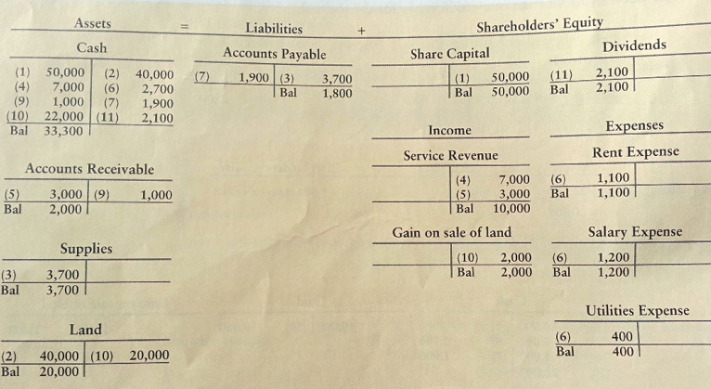

Slide 6
Transactions
Copyright ©2014 Pearson Education
ALL Events that have a financial impact on the business and can be measured reliably
Selling products
Paying expenses
Have two sides:
Giving
Receiving
Accounting records both sides of transactions
Often called Double-entry Accounting
Notes:
人力资本无法用金钱衡量，不是奴隶社会了。

Slide 7
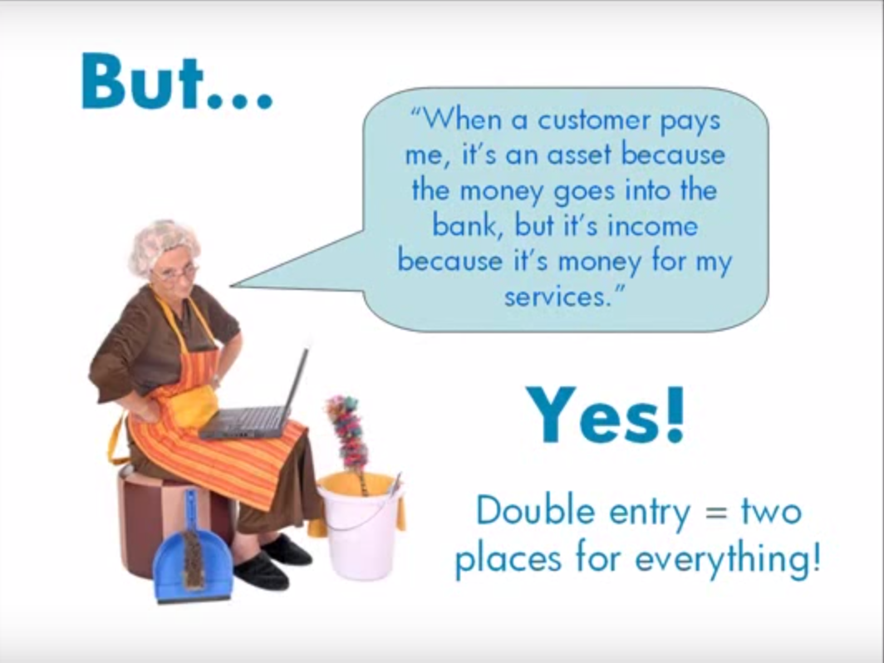

Slide 8
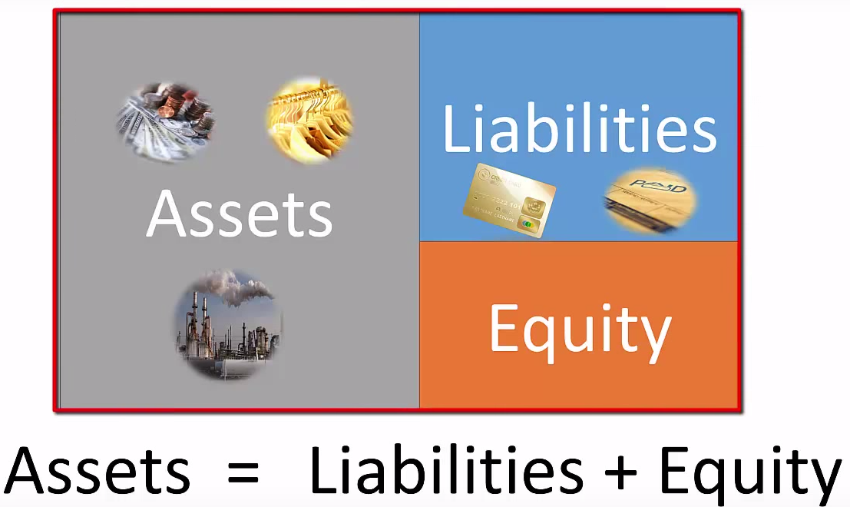
Copyright ©2014 Pearson Education
An Account is a record of all the changes in a particular asset, liability and shareholders’ equity element
Basic summary device of accounting
Notes:
科目 An Account：记账的最小单元

Slide 9
Chart of Accounts
A Chart of Accounts shows what account number is used for which account and is different for each company.
Balance Sheet Accounts
Assets |  | Liabilities |  | Shareholders’ Equity
101 | Cash | 201 | Accts. payable | 301 | Share capital
111 | Accts. receivable | 231 | Notes payable | 311 | Dividends
141 | Office supplies |  |  | 312 | Retained earnings
151 | Office furniture | Income Statement Accounts
191 | Land | Revenues |  | Expenses
 |  | 401 | Service revenue | 501 | Rent expense
 |  |  |  | 502 | Salary expense
 |  |  |  | 503 | Utilities expense
Appendix C: Service/Merchandising/Manufacturing Corporation
Copyright ©2014 Pearson Education

Slide 10
Assets
Asset Name | Description
Cash | Money and any medium of exchange including bank account balances, paper currency, coins, certificates of deposit, and checks.
Accounts Receivable 应收账款 | Companies sell their goods and services and receives a promise for future collection of cash. The Accounts receivable account holds these amounts. (from customers)
Notes Receivable 应收票据（有利息） | A note receivable is similar to an account receivable, but a note receivable is more binding because the borrower signs a note, often with a specific interest rate. (from borrowers)
Inventory | The products a company sells to customers. Other titles for this account include Stocks and Merchandise inventory.
Prepaid Expenses | A future expense that has already been paid. Examples: Prepaid rent, Prepaid insurance, and Supplies.
Land | The Land account shows the cost of the land a company uses in its operations.
Buildings | The costs of office buildings, manufacturing plants, etc.
Equipment, Furniture, and Fixtures | These asset accounts includes items such as computers, office furniture and store shelving.
 | (Land, Buildings, Equipment are commonly combined into PPE)
Notes:
Cash 是可以随时支取的，包括活期金融产品例如支票
Prepaid Expenses：会带来将来的收益，例如预付租金，但是随着时间的流逝，就会慢慢变成费用。
Prepaid rent：预付了一年60w的租金，最开始预付的时候60w都是资产，一个月后，扣除其中的5w变成了费用，剩下55w的预付款还是资产）费用逐月增加，资产逐月减少。
Prepaid insurance：保险，事前付，到期前都是资产。
Supplies 低值易耗品，月初进行采购，月末进行盘点。
*先给钱（预付租金或保险）和后给钱（信用卡）都是Accrual

Slide 11
Liabilities
Liability Name | Description
Accounts Payable | The direct opposite of Accounts receivable. A company’s promise to pay a debt arising from a credit purchase.
Notes Payable 应收票据，有利息 | A note payable is the opposite of a note receivable. The Notes payable account includes the amounts a company must pay because it signed notes promising to pay a future amount, typically with interest.
Accrued Liabilities 不是某一科目，而是一类科目的归类 | An accrued liability is a liability for an expense you have not yet paid. 包括以下科目：Interest payable and Salary payable are accrued liability accounts for most companies. Income tax payable is another accrued liability.

Slide 12
Shareholders’ Equity
Equity Name | Description
Share Capital | The owners’ investment in the corporation. The corporation receives cash and issues shares to its shareholders. A company’s ordinary share capital (Common Stock) is its most basic element of equity. All corporations have ordinary shares.
Retained Earnings | this account shows the cumulative net income earned by a corporation over its lifetime, minus its cumulative net losses and dividends.
Dividends | Dividends are optional; they are declared by the board of directors and represent a payment from retained earnings back to shareholders
Revenues | the increase in shareholders’ equity from delivering goods or services to customers: includes sales revenue, service revenue, interest revenue, rent revenue, etc.
Expenses | the cost of operating a business. Expenses decrease shareholders’ equity, the opposite effect of revenues. Examples include: Cost of goods sold, Salary expense, Rent expense, Advertising expense, Insurance expense, Utilities expense, and Income tax expense. Businesses strive to minimize expenses and thereby maximize net income

Slide 13
ShineBrite Car Wash, Inc
Record transactions using only accounting equation:
Transaction 1. Gray and a few friends invest $50,000 to open ShineBrite Car Wash, and the business issues ordinary share capital to the shareholders.
Transaction 2. ShineBrite purchases land for a new location and pays cash of $40,000.
Transaction 3. The business buys supplies on account, agreeing to pay $3,700 within 30 days.
Transaction 4. ShineBrite earns $7,000 of service revenue by providing services for customers. The business collects the cash.
Transaction 5. ShineBrite performs $3,000 of service on account, which means that ShineBrite lets some customers pay later.
Transaction 6. During the month, ShineBrite Car Wash pays $2,700 for the following expenses: equipment rent, $1,100; employee salaries, $1,200; and utilities, $400.
两种情况Revenue都增加
Notes:
一个例子
Transaction:
发股筹资
Cash
赊购低值易耗品
提供服务（洗车公司，如果是耐克可能就提供商品）
赊销
费用

Slide 14
ShineBrite Car Wash, Inc
Copyright ©2014 Pearson Education
Notes:
根据会计恒等式做记录，但是交易多的话这种方法会不实用
A = S + L
1. A 中的 Cash 加五万，E 中的 Share capital 加五万
2. A 中的 Cash 减四万，Land 加四万
3. Supplies 增加 3700，Liabilities 增加 3700
4. Assets 加 七千，Revenue加七千即 RE +7000
5. Accounts receivable 加 三千，RE加三千
6. Cash -2700 另一边 Expenses + 2700 即 RE – 2700

Slide 15
ShineBrite Car Wash, Inc
Transaction 7. ShineBrite pays $1,900 on account, which means to pay off an account payable.
Transaction 8. Van Gray, the major shareholder of ShineBrite Car Wash, paid $30,000 to remodel his home.
Transaction 9. In transaction 5, ShineBrite performed services on account. The business now collects $1,000.
Transaction 10. ShineBrite sells some land for $22,000, which is the same amount that ShineBrite paid for the land.
Transaction 11. ShineBrite Car Wash declares a dividend and pays the shareholders $2,100 cash.
Notes:
7. 偿还应付账款
8. 个人业务不算入公司账上
9. 收回应收账款
10. 卖土地和Gains收获差价
11. 分红

Slide 16
ShineBrite Car Wash, Inc
$57,000
$57,000
Copyright ©2014 Pearson Education
Notes:
7. Cash -1900 Liablities Account Payable -1900
8. 个人业务，不计在公司的账上，No report
9. Cash + 1000 Accounts Recievable -1000
10. Cash + 2w2，Land – 2w2（假设有差价，则算到 Gains 里面，不能算到 Revenues 里面）
11. Cash - 2100, Equity 中 Dividend + 2100 而 RE – 2100

Slide 17
ShineBrite Car Wash, Inc
Income Statement Data
Statement of Changes in Equity Data
Statement of Cash Flows Data
$57,000
Balance Sheet Data
Copyright ©2014 Pearson Education
Notes:
1.The difference between single and double
2. T account
3. Debit,credit.
4. According to accounting equation, in what condition, debit side record increasing.

Slide 18
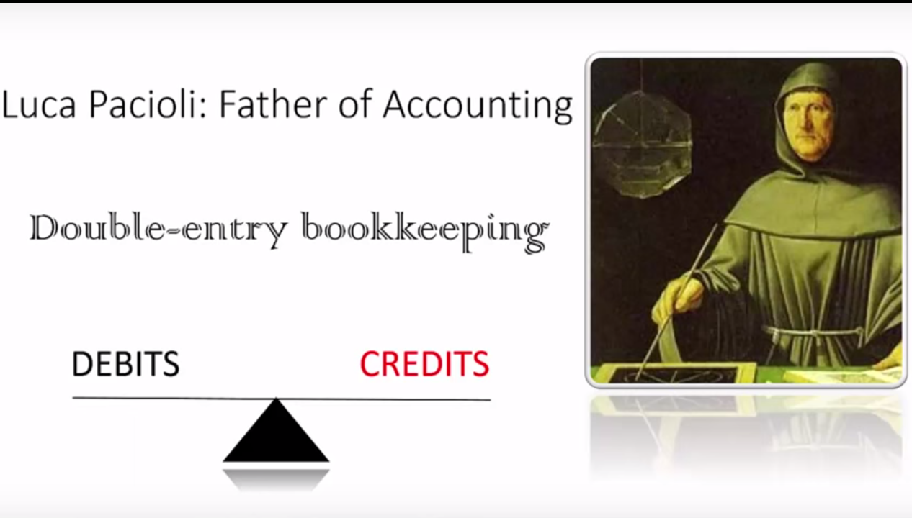

Slide 19
Double-Entry Accounting
Copyright ©2014 Pearson Education
Business transactions include two parts
Giving
Receiving
Accounting based on a double-entry system
Each transaction affects at least two accounts

Slide 20
T-Account
Account Title
Left side
Right side
Debit
Credit
Copyright ©2014 Pearson Education

Slide 21
Rules of Debit and Credit
Shareholders’ Equity
Assets
Liabilities
Debit
Credit
Debit
Credit
Debit
Credit
Copyright ©2014 Pearson Education
Notes:
语法一：左Debit，右Credit
语法二：借贷必相等（Debit 一定等于 Credit）
语法三：
资产左边代表增加（即Debit代表增加）
负债和所有者权益右边增加（即Credit代表增加）

Slide 22
Additional Shareholders’ Equity Accounts: Revenues & Expenses
Assets
Liabilities
Share Capital
+
Shareholders’ Equity
Beginning Retained Earnings
+
Revenues
Expenses
Dividends
Copyright ©2014 Pearson Education

Slide 23
Rules of Debit and Credit
Shareholders’ Equity
Assets
Liabilities
Share Capital
Retained earnings
Debit
Credit
Debit
Credit
Debit
Credit
Debit
Credit
-
-
-
-
Dividends
Debit
Credit
-
Revenue
Expenses
Debit
Credit
Debit
Credit
-
-
Copyright ©2014 Pearson Education
Notes:
1. Debit 增加：Assets, Dividends, Expenses
2. Credit 增加：Liabilities, Share Capitals, Retained Earnings, Revenues

Slide 24
Normal Balances of Accounts
Take 1 minute to fill out what is the normal balance of each type of account
Assets | Debit
Liabilities |  | Credit
Shareholders’ Equity overall |  | Credit
Share capital |  | Credit
Retained earnings |  | Credit
Dividends | Debit
Revenues |  | Credit
Expenses | Debit
Copyright ©2014 Pearson Education
Notes:
Normal Balance 正常情况下一般会在哪一方
例如正常情况下，资产会增加，Assets会在Debit下。

Slide 25
Normal Balances of Accounts
Assets | Debit
Liabilities |  | Credit
Shareholders’ Equity overall |  | Credit
Share capital |  | Credit
Retained earnings |  | Credit
Dividends | Debit
Revenues |  | Credit
Expenses | Debit
Copyright ©2014 Pearson Education
Notes:
都是在增加一方的

Slide 27
The Journal
Copyright ©2014 Pearson Education
Chronological record of transactions
Three steps
1. Specify each account affected by the transaction and classify by type
2. Determine if each account is increased or decreased
Use debit credit rules
3. Record in journal with amount (called an entry or journal entry)
Notes:
日记账

Slide 28
ShineBrite Car Wash, Inc
Reporting entity
Trans# | Description
1 | Gray and a few friends invest $50,000 to open ShineBrite Car Wash, and the business issues ordinary share capital to the shareholders.
2 | ShineBrite purchases land for a new location and pays cash of $40,000.
3 | The business buys supplies on account, agreeing to pay $3,700 within 30 days.
4 | ShineBrite earns $7,000 (cash) of service revenue by providing services for customers.
5 | ShineBrite performs $3,000 of service on account.
6 | During the month, ShineBrite Car Wash pays $2,700 for the following expenses: equipment rent, $1,100; employee salaries, $1,200; and utilities, $400.
7 | ShineBrite pays $1,900 on account, which means to pay off an account payable.
8 | Van Gray paid $30,000 to remodel his home.
9 | In transaction 5, ShineBrite performed services on account. The business now collects $1,000. (We say that ShineBrite collects the cash on account)
10 | ShineBrite sells half of the land they purchased for $22,000.
11 | ShineBrite Car Wash declares a dividend and pays the shareholders $2,100 cash.

Slide 29
Journal Entry Example
JOURNAL
Trans# | Accounts and explanation | Debit | Credit
1 | Cash | 50,000
 | Share Capital |  | 50,000
 | Issued ordinary shares
Do journal entry exercises for the following transations.
Copyright ©2014 Pearson Education
Notes:
除了幻灯片中的写法，推荐用下面的写法
第一行顶格写 Debit 科目 金额
换行空两格写 Credit 科目 金额
且Debit 顶格写，Credit 空两格写
Debit Cash 50,000
Credit Share Capital 50,000
Debit Land 40,000
Credit Cash 40,000
Debit Supplies 3,700
Credit Accounts Payable 3,700
Debit Cash 7,000
Credit Service Revenue 7,000
Debit Accounts Receivable 3,000
Credit Revenue 3,000
Debit Rent Expense, Salary Expense, Utilities Expense 2,700
Credit Cash 2,700
Debit Accounts Payable 1,000
Credit Cash 1,000
Debit Cash 1,000
Credit Accounts Receivable 1,000
Debit Cash 22,000
Credit Land 20,000
Credit Gain on sale of land 2000(差价)
Debit Dividends 2,100
Credit Cash 2,100

Slide 30
Trans# | Accounts and explanation | Debit | Credit
2 | Land | 40,000
 | Cash |  | 40,000
 | Paid cash for land.
3 | Supplies | 3,700
 | Accounts Payable |  | 3,700
 | Purchased office supplies on account.
4 | Cash | 7,000
 | Service Revenue |  | 7,000
 | Performed services for cash.
5 | Accounts Receivable | 3,000
 | Service Revenue |  | 3,000
 | Performed services on account.
6 | Rent Expense | 1,100
 | Salary Expense | 1,200
 | Utilities Expense | 400
 | Cash |  | 2,700
 | Paid expenses.

Slide 31
Trans# | Accounts and explanation | Debit | Credit
7 | Accounts Payable | 1,900
 | Cash |  | 1,900
 | Paid cash on account.
8 | No entry.
9 | Cash | 1,000
 | Accounts Receivable |  | 1,000
 | Collected cash on account.
10 | Cash | 22,000
 | Land |  | 20,000
 | Gain on sale of land |  | 2,000
 | Sold land costing $20,000 for $22,000.
11 | Dividends (it will reduce equity) | 2,100
 | Cash |  | 2,100
 | Declared and paid dividends.

Slide 32
Posting (journal ➔ ledger)
JOURNAL
Date | Accounts and explanation | Debit | Credit
May 1 | Cash | 50,000
 | Share Capital |  | 50,000
 | Issued ordinary shares
Cash
Share Capital
Transferring an amount from the Journal to a Ledger is called Posting: Example: post $50,000 to the cash ledger
$50,000
$50,000
Copyright ©2014 Pearson Education
Notes:
过账到T字账

Slide 33
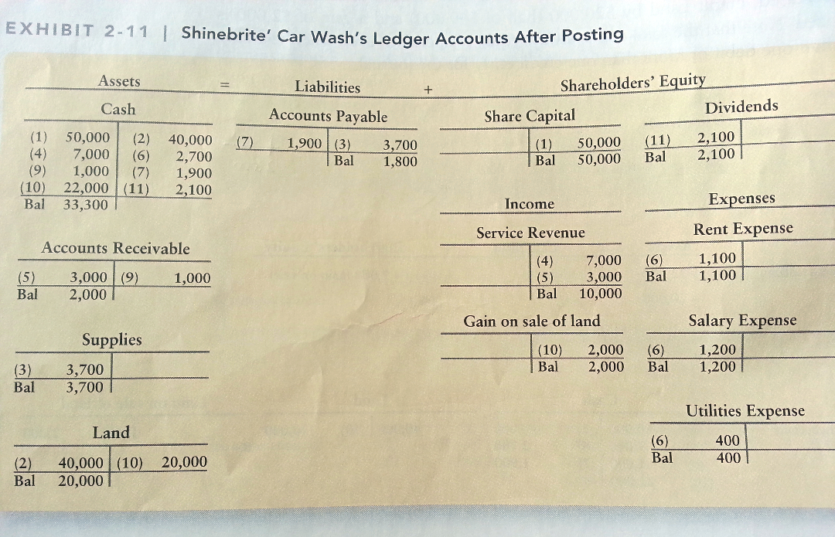
Notes:
算出Ending Balance(Bal)应该与前面的 Normal Balance 方向一致

Slide 34
Trial Balance
Copyright ©2014 Pearson Education
Lists all accounts with their balances
Assets listed first, then liabilities and shareholders’ equity
Shows that debits equal credits
Usually prepared at the end of the period

Slide 35
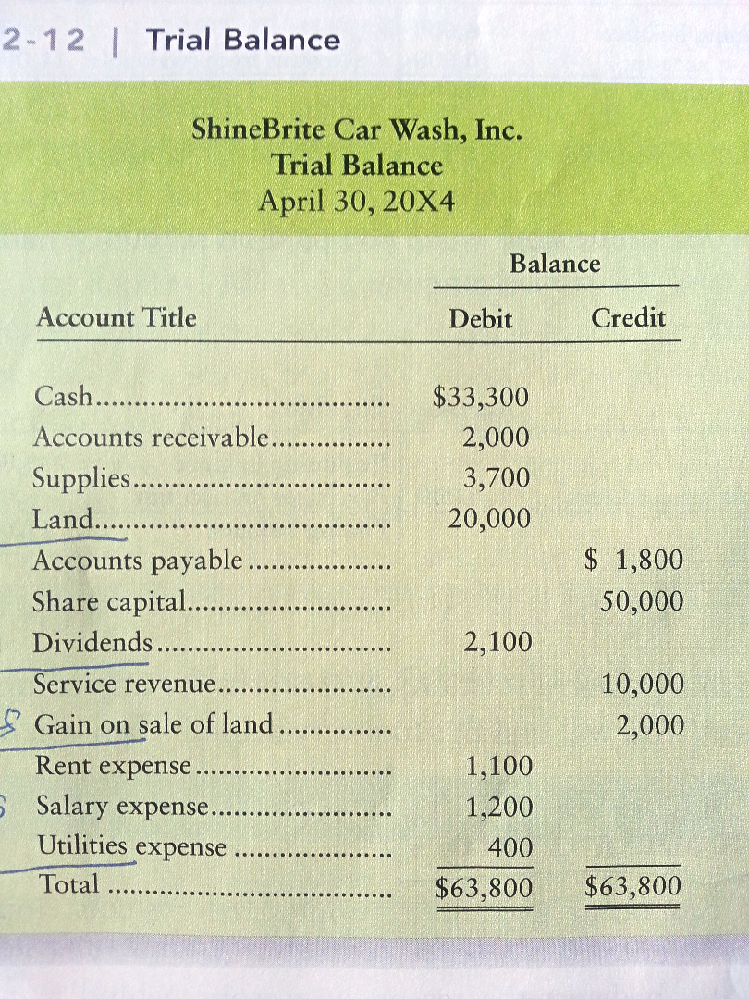
Assets
Liabilities
Revenues
Equity
Expenses
Notes:
如果抄错了，比如把2100的Debit抄到Credit里了，最后的Balance会差4200，所以需要除以2来看

Slide 36
Using T-Accounts
Copyright ©2014 Pearson Education
Decisions often are made without a complete accounting system
T-Accounts allow managers to analyze transactions quickly

Slide 37
Analyzing Accounts
Cash (A)
Beginning balance
?
- Cash payments
+Cash receipts
Ending balance
Normal Balance
Copyright ©2014 Pearson Education
Notes:
给定其中任意三个，就可以求解一个

Slide 38
Analyzing Accounts
Accounts payable (L)
Beginning balance
?
Payments on account
Purchases on account
Ending balance
Normal Balance
Copyright ©2014 Pearson Education

Slide 39
Correcting Accounting Errors
Missing account
Trace each account from journal to ledger
Divide out-of-balance amount by 2
Reversing debits and credits doubles the error
Divide out-of-balance amount by 9
If even, error may be a 总是9的倍数
Slide (writing $200 as $20)
Transposition (writing $210 as $120)
Copyright ©2014 Pearson Education

Slide 40
Short Exercise 2-13
Seventh Investments, Inc., began by issuing shares for cash of $140,000. The company immediately purchased computer equipment on account for $100,000.
1. Set up the following T-accounts of Seventh Investments, Inc.---Cash, Computer equipment, Accounts payable, Share capital.
2. Record the first two transactions of the business directly in the T-accounts without using a journal.
3.Show that total debits equal total credits.

Slide 41
Short Exercise 2-13
Cash
Computer Equipment
$140,000
$100,000
Accounts Payable
Share Capital
$100,000
$140,000
Debits = $240,000
Credits = $240,000
Copyright ©2014 Pearson Education

Slide 42
Review of Chapter 2
Accounting is based on a double-entry system: Each transaction affects at least two accounts.
Rules of debit and credit (normal balance?)
Assets=Liability + Equity
Debit Credit Credit
Net income=Revenue-Expenses
Credit Credit Debit
Accounting process:
Transactions ➔ Journals ➔ ledger ➔ trial balance ➔ financial statements ➔ business decisions

Slide 43
What will we learn in Chapter 3?
Accrual accounting.
Revenue recognition and matching principles.
Prepare the financial statements.
Adjust the accounts.
Close the book.

